Slide 1


Evaluating Sales Dynamics for Conagra (2020–2024)
MATS Consulting
Shadi Tabba
Manyata Agrawal
Tharun Bedapudi
Akshay Kulkarni

Slide 2
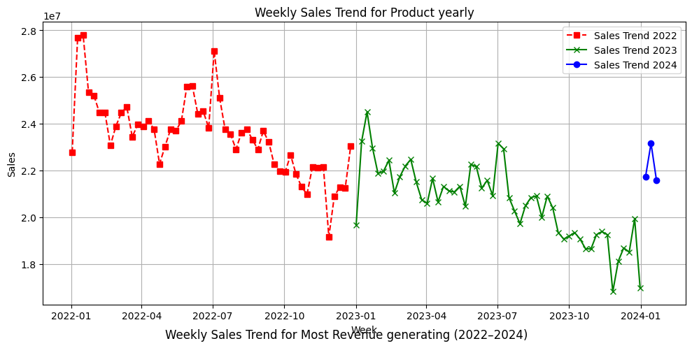
Why This Project Matters?
The Meat Alternatives Category Is Under Pressure
Plant-based meat sales have declined after the early 2020–2021 boom.
Inflation made plant-based options less competitive vs real meat.
Consumers perceive plant-based meats as processed, reducing appeal.
Novelty has worn off; fewer new customers entering the category.
Competitors like Impossible Foods entered retail aggressively.

Slide 3

Why Is the Category Declining?
Consumer + Market Forces Identified:
Inflation raised plant-based prices → reduced value perception
“Processed” image reduces trust
Taste/texture inconsistency leads to trial but not repeat
Early novelty of plant-based options has faded
Consumers prefer familiar, clean ingredients (poultry, eggs, etc.)

Slide 4
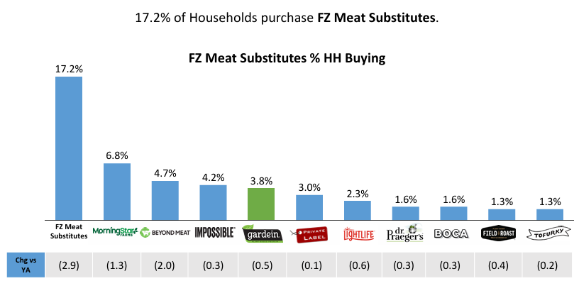
Low Household Penetration
With only 17.2% of households purchasing meat substitutes, limited consumer engagement presents significant growth challenges for Conagra.
Only 17.2% of households buy meat substitutes
Limited reach = restricted growth
Few new buyers entering the category

Slide 5
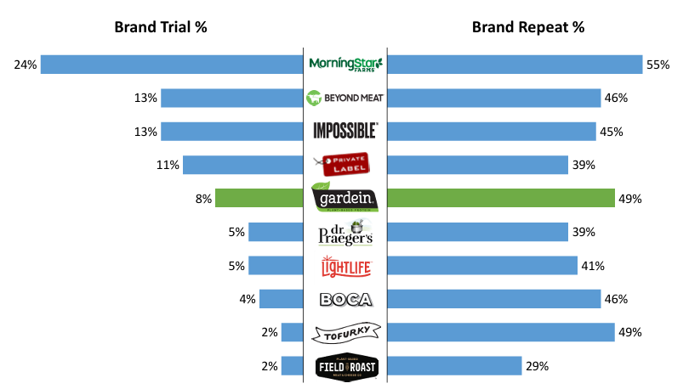
Competitive Pressure
With Impossible Foods capturing high-spend buyers rapidly, Conagra must enhance its market presence and consumer appeal.
Category dominated by Morningstar, Beyond, Impossible
Impossible attracting high-spend buyers fastest
Conagra lags in trial & trip rate
Growth requires winning share, not new buyers

Slide 6

How We Investigated the Decline?
We analyzed:
Product attributes: form, flavor, package, type, cooking instructions
Brand-level influence
SKU-level unit, dollar, and velocity performance
Machine Learning model (Random Forest feature importance)
Price elasticity modeling (log–log OLS)
ACV impact modeling
Assortment clustering (K-means)
Distribution trend analysis (Conagra vs Impossible)

Slide 7

What factors most strongly drive weekly unit sales?
Methods used:
Attribute analysis
Random Forest feature importance
SHAP impact summary
ACV vs sales relationships

Slide 8
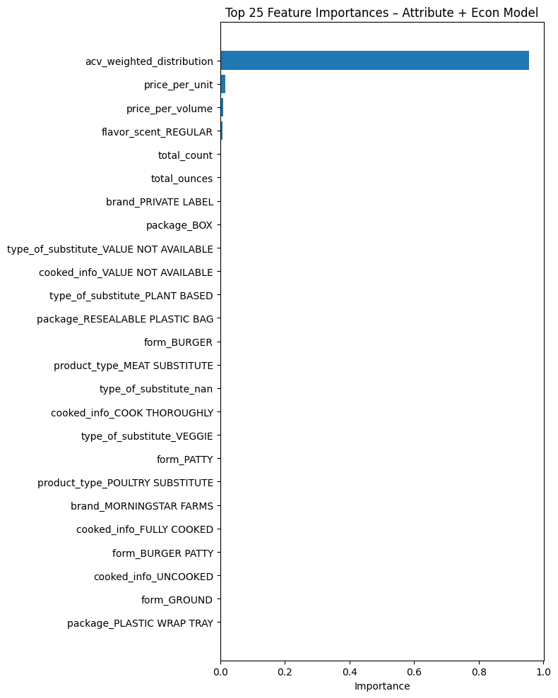
Key Drivers Identified (Feature Importance)
ACV Weighted Distribution is by far the #1 driver → Accounts for ~95% of total model importance
Price has a small but real effect → Higher prices reduce sales, but the contribution is < 2% of importance
Top non-price, non-ACV factors:
Flavor: Regular/Original
Form: Burger, Patty, Ground (but small effect)
Package type: box vs resealable bag (minor)
Brand effects (Private Label carries slight advantage)

Slide 9
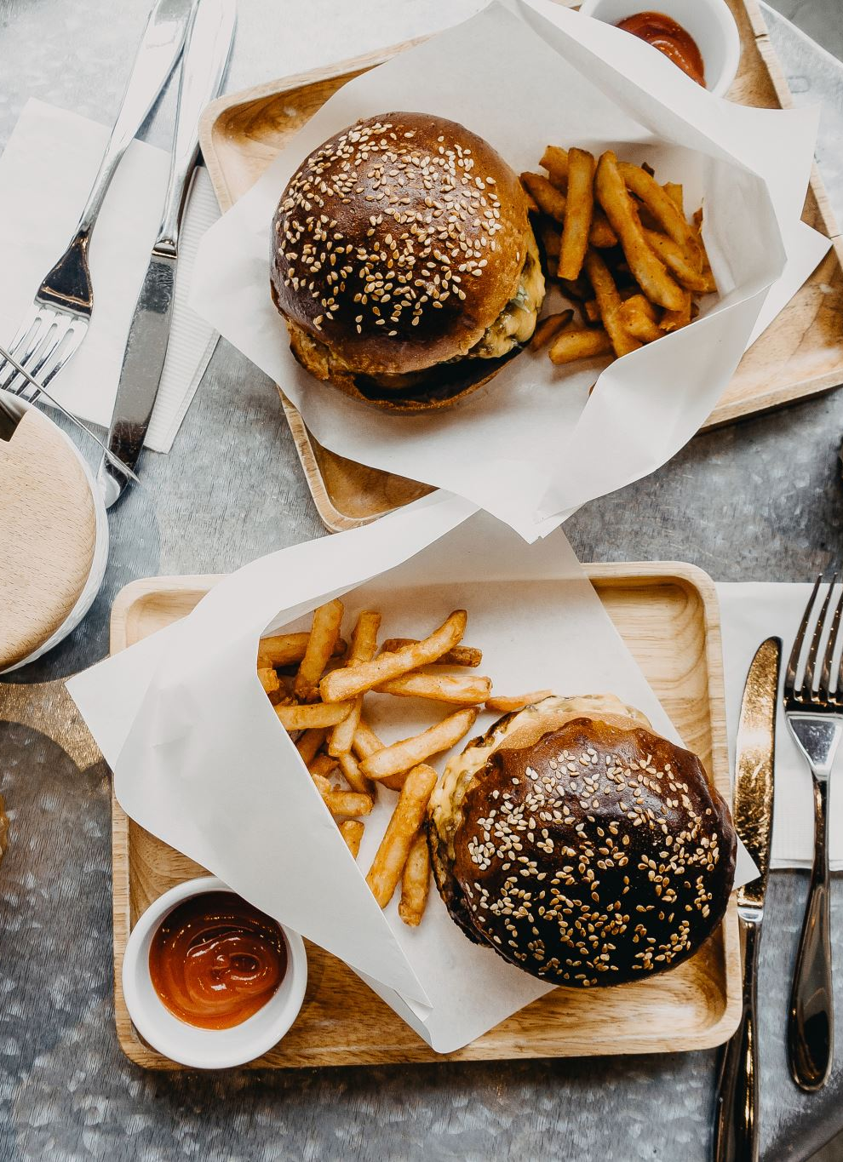
What Consumers Are Telling Us?
Based on our descriptive attribute analysis:
Burgers, ground, tenders, and meatballs sell highest in absolute volume
Regular / Original flavors overperform
Resealable bags outperform boxes
Usage versatility increases sales potential
But ACV explains far more variation than attributes.

Slide 10
Brand Comparison: Conagra vs Competitors
Impossible’s ACV reached ~40% (Conagra ~10–14%)
Competitors operate with fewer SKUs and tighter brand identity
Conagra’s broad assortment creates mixed performance
Higher SKU count increases internal cannibalization

Slide 11
How does price influence sales and velocity?
We evaluated:
Unit & volume elasticity
Price thresholds (banding analysis)
Price vs velocity scatter patterns
Conagra vs category price positioning

Slide 12
Price Elasticity Results
Unit Elasticity: – 0.44
Unit demand is moderately inelastic
Small price increases will not significantly hurt sales
Volume Elasticity: – 1.09
Volume SKUs more price-sensitive
Important for managing revenue scale
ACV Elasticity: + 0.97
Distribution nearly equals sales lift
10% ACV increase → ~9.7% sales lift

Slide 13
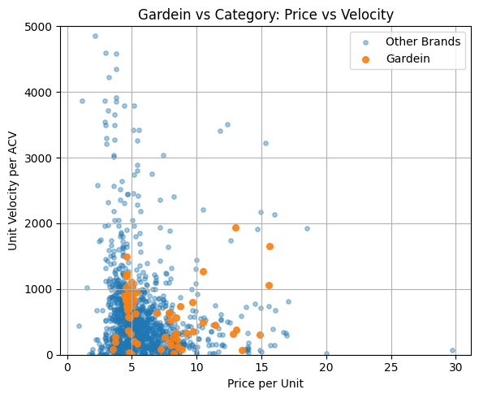
Price Threshold Analysis
Price band insights:
Highest velocity at $3.50–$4.50
Sharp decline in velocity after $4.75
Premium brands succeed near $6.99–$7.25
Prices above $5.50 push items into lower-demand tiers

Slide 14

Pricing Strategy Implications
Keep core pricing between $3.50–$4.50
Avoid heavy discounting—elasticity is low
Use promotions strategically on volume SKUs
Consider premium-tier offerings (~$7.00+)
Price architecture should match SKU role in portfolio

Slide 15
How should Congara optimize its assortment using velocity, ACV, and pricing?
Methods used:
K-means clustering
Velocity per ACV (true demand)
Distribution analysis
Conagra vs category cluster mapping

Slide 16
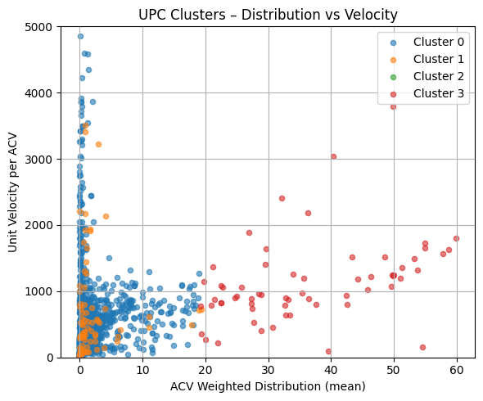
Clustering Results (4 Segments)
Cluster 3 — Core Winners
High velocity, high ACV
Should be expanded and supported
Conagra has 10 SKUs here
Cluster 2 — Hidden Gems
Extremely high velocity, but very low ACV
Huge distribution opportunity
Conagra has 0 SKUs here → white space
Cluster 1 — Premium/Niche
Higher price, moderate velocity
Supports special occasions, not core growth
Cluster 0 — Underperformers
Low ACV + low velocity
Conagra has 44 SKUs here
Ideal candidates for rationalization

Slide 17
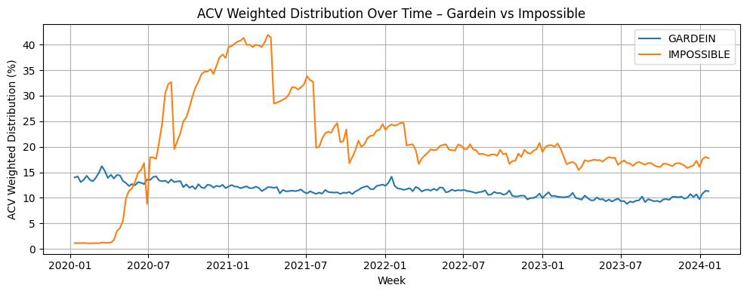
Competitive Distribution Insights
Impossible’s distribution surge is the primary reason behind its growth
Conagra shows stable but flat ACV over 4 years
Distribution gaps explain most performance differences
ACV improvement offers immediate incremental units

Slide 18

What Can We Do?
Maximize Distribution (Top Priority)
Optimize Pricing Strategy
Strengthen Assortment Discipline

Slide 19
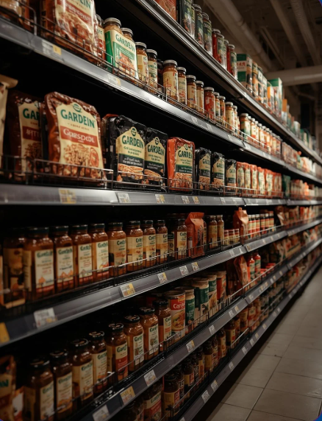
Maximize Distribution
ACV is the strongest sales driver (~95% importance; elasticity ≈ +1.0)
Expand ACV for Cluster 3 core SKUs
Close the distribution gap vs Impossible
Use velocity-per-ACV data to secure more facings
Reduce or remove distribution for low-productivity SKUs

Slide 20
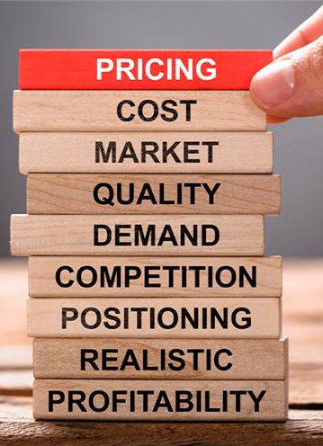
Optimize Pricing Strategy
Maintain mainstream pricing in $3.50–$4.50 sweet spot
Avoid unnecessary discounting — unit elasticity is small (–0.44)
Promote volume/value packs, which are more price sensitive (elasticity –1.09)
Explore premium-tier items at $6.99+ with higher protein, culinary positioning, and upgraded packaging
Introduce Gardein Essentials and Premium Lines

Slide 21
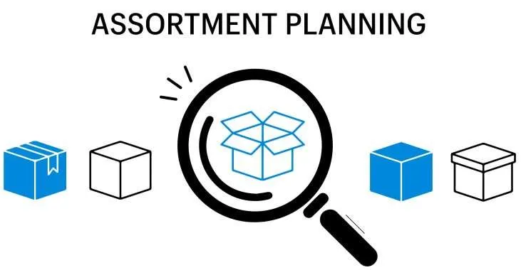
Strengthen Assortment Discipline
Rationalize Cluster 0 SKUs (low ACV + low velocity)
Expand distribution and support for Cluster 3 core winners
Innovate into Cluster 2 whitespace — high velocity, low distribution formats
Maintain selective premium items (Cluster 1) without overexpansion
Reduce SKU redundancy in similar forms/flavors

Slide 22





Thank you

